Slide 1


Large Language Models for Digital Forensics
Hans Henseler (NFI, UoSL) Gaëtan Michelet (UNIL)
DFRWS EU 2024, Workshop,
March 19, 2024, Zaragoza, Spain

Slide 2
Agenda
Time | Title
11:00 | Introduction Large Language Models
11:30 | Part I: Hands-on prompt engineering for digital forensics
12:15 | Break
12:30 | Part II: Hands-on with Llama2
12:50 | Wrap up

Slide 3
Introduction Large Language Models
Part I: Hans Henseler

Slide 4


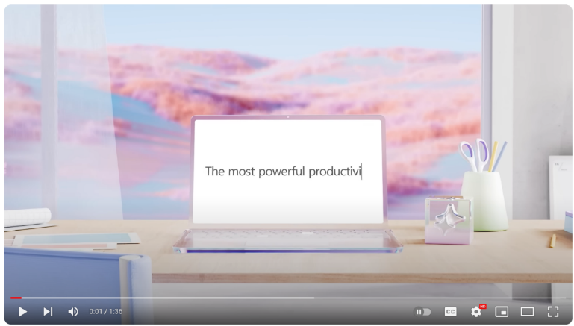

Microsoft Copilot
2021 GitHub Copilot
February 1: Bing Chat
September 26 : Windows 11 Copilot
November 1: Microsoft Office 365 Copilot:
Introducing Microsoft 365 Copilot | Your Copilot for Work - YouTube

Slide 5
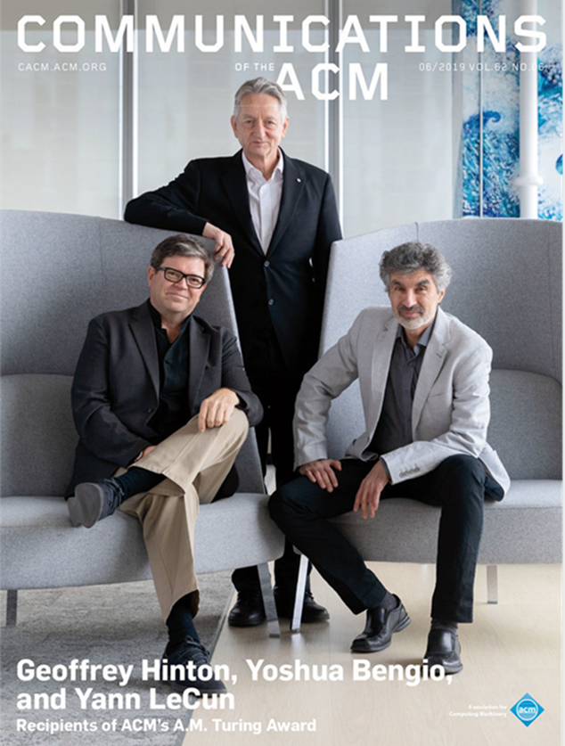
The rise of deep learning 2012-2022
2012: AlexNet wins the ImageNet Large Scale Visual Recognition Challenge
2014: Introduction of Generative Adversarial Networks (GAN's)
2015: AlphaGo defeats world champion Go, Lee Sedol
2017: Google introduces BERT improving ML translations
2018-2021: Introduction of GPT-2, DALL-E, CLIP, GPT-3, …
2022: DALL-E2, Midjourney, Stable Diffusion, ChatGPT, …
2023: GPT4, Llama2 (Meta), Claude 2 (Anthropic), Mistral, Grok (X)
2024: Gemini (Google), Mistral Large, Claude 3 …

Slide 6
What is ChatGPT?
ChatGPT is a large language model (LLM)
Essentially a machine learning model that learns an algorithm to predict the next word based on many text examples
Based on GPT3.5/GPT4 (Generative Pre-trained Transformer)
Improved version of GPT-3 that “understands” text and program code
Different models for performance, chat, text and code completion
GPT3.5 was trained on 570 GB data from the internet (articles, posts, web pages and books)
Available as
Free version
ChatGPT-plus €23 per month
OpenAI playground (API access):
GPT3.5-turbo API 0,002 dollar per 1.000 tokens, ~700 words
GPT4 API 0,03 dollar per 1.000 tokens, ~700 words

Slide 7
What can ChatGPT do?
Chat. Like a chatbot that…
Assists with writing and brainstorming
Tells riddles, jokes, stories
Plays games
Gives compliments and advise
Helps with filling in forms
But it that can also:
Summarise
Translate
Analyse and structure (unstructured) information
Answer questions (but the answer may not be right)
Assist with software writing and debugging
Generate (anonymous) testdata

Slide 8
What can ChatGPT not do?
REMINDER
use LLMs as
co-pilot
It hallucinates facts
It gives wrong answers
Replies can be biased
Can not act spontaneously (needs to be prompted)
Is not good at making calculations (e.g. 4213x8242)
Is limited to generating text output
Can accidentally reveal sensitive training data
…?

Slide 9

Thoughts on using AI for forensic purposes
Hansken is:
used for investigations, bit
designed for evidentiary use
Evidentiary use is more strict:
Accurate
Repeatable
Reproducible
So algorithms must be:
Explainable
Validated
Deterministic
Not depend on external data
Artificial Intelligence:
Use external data: Training sets
Use external data: Cause bios
Lacks explainability
Use AI for investigative purposes,with
Disclaimer
Education
By the way:
Not all currently used algorithms are good
Data under investigation can results from AI itself
https://blog.ampedsoftware.com/2021/10/05/can-ai-be-used-for-forensics-and-investigations

Slide 10
Hallucinations, data privacy and explainability
Preventing hallucinations:
Provide clear prompts to ChatGPT to base its response on digital traces
ChatGPT should not hallucinate but inform that there are no relevant traces
Retrieval-Augmented-Generation (RAG) comes to the rescue
Explicit references to the source on which a response is based
Maintaining data privacy:
Digital traces and case specific details can not be send to the public cloud (e.g., ChatGPT in the OpenAI cloud)
Powerfull Large Language Models can already be deployed on premise (e.g., Meta’s Llama 2)
Assumption: Open source LLMs with RAG do not need the extensive factual knowledge as ChatGPT/GPT-4
Explaining responses:
Identify the sources that were retrieved as part of the RAG method to explain the response
Reproducability over creativity (experiment with “temperature” of the LLM)

Slide 11

Topics for future work
Can we do this off-line with the same quality?
Build a co-pilot in Hansken leveraging Retrieval Augmented Generation (RAG)
Evaluate with (real) users
Advanced topics:
Multi-modal generative transformers (Visual ChatGPT)
Augmented language models
Planning an investigation
Midjourney prompt: Looking in a crystal ball seeing the future of artificial intelligence, ultra HD, super realistic, cinematic lighting. (fast)

Slide 12
How smart are LLMs?
Model | Score
garage-bAInd/Platypus2-70B-instruct | 73.13
upstage/Llama-2-70b-instruct-v2 | 72.95
fangloveskari/Platypus_QLoRA_LLaMA_70b | 72.94
yeontaek/llama-2-70B-ensemble-v5 | 72.86
TheBloke/Genz-70b-GPTQ | 72.82
TheBloke/Platypus2-70B-Instruct-GPTQ | 72.81
psmathur/model_007 | 72.72
yeontaek/llama-2-70B-ensemble-v4 | 72.64
psmathur/orca_mini_v3_70b | 72.64
ehartford/Samantha-1.11-70b | 72.61
MayaPH/GodziLLa2-70B | 72.59
psmathur/model_007_v2 | 72.49
chargoddard/MelangeA-70b | 72.43
ehartford/Samantha-1.1-70b | 72.42
psmathur/model_009 | 72.36
Hugging Face open LLM leaderboard:
https://huggingface.co/spaces/HuggingFaceH4/open_llm_leaderboard
Score gebaseerd op:
ARC: Abstraction en Reasoning Challenge
HellaSwag: een benchmark die zich richt op gezond verstand redeneren
MMLU: Massive Multitask Language Understanding
TruthfulQA: een benchmark die beoordeelt of een taalmodel waarheidsgetrouwe antwoorden genereert

Slide 13
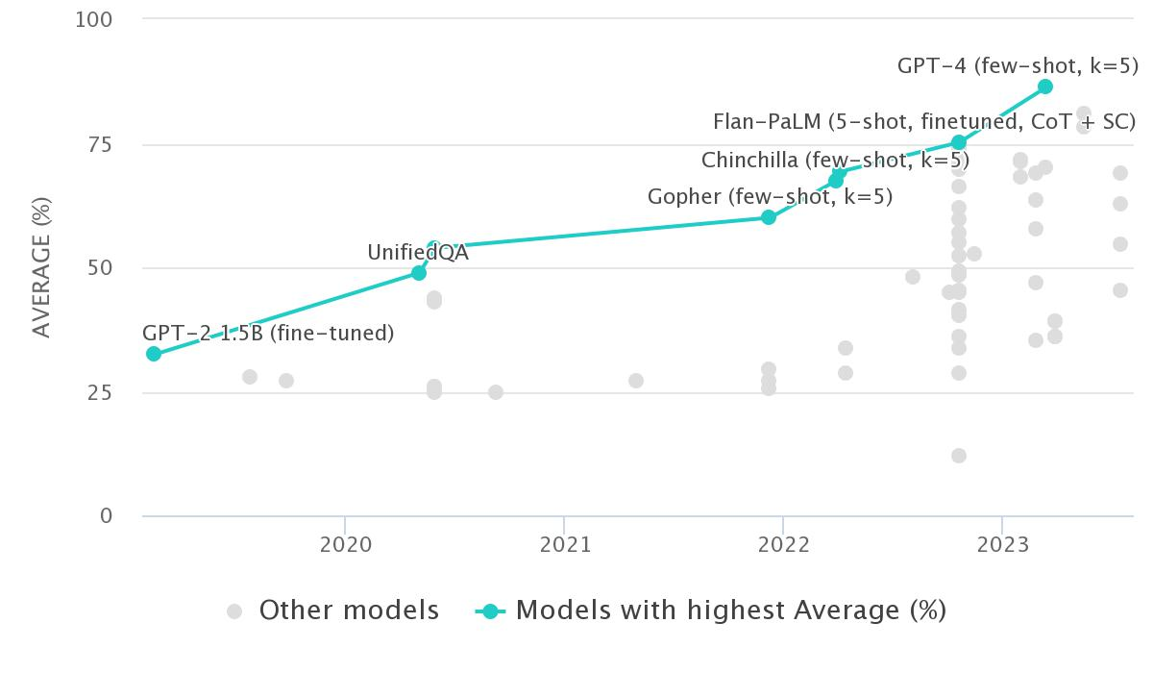
MMLU 2019-2023
Llama 2 70B
Llama 2 35B
Llama 2 13B
Llama 2 7B
https://paperswithcode.com/sota/multi-task-language-understanding-on-mmlu

Slide 14
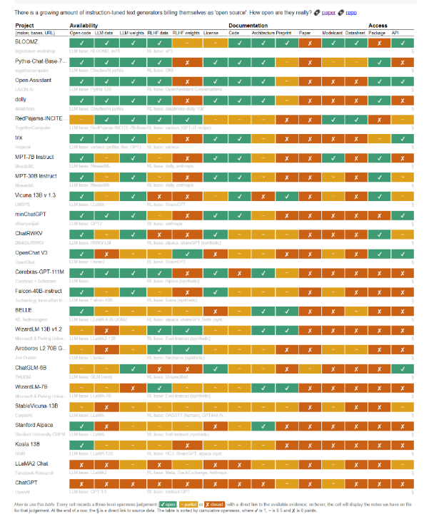
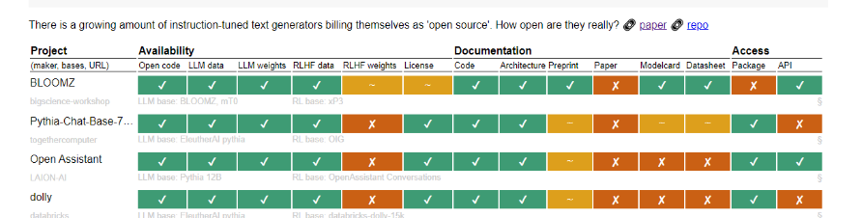
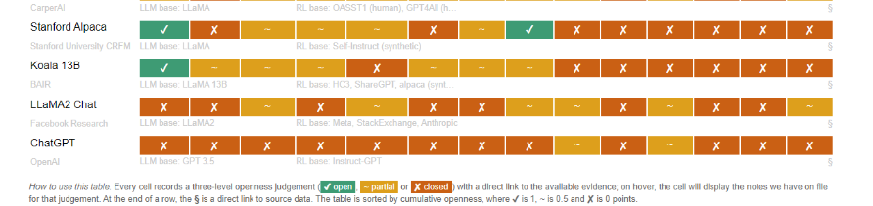
How open are LLMs?
Researchers from Nijmegen University:
Opening up ChatGPT: tracking "open source" LLM + RLHF architectures
https://opening-up-chatgpt.github.io/

Slide 15
Agenda
Time | Title
11:00 | Introduction Large Language Models
11:30 | Part I: Hands-on prompt engineering for digital forensics
12:15 | Break
12:30 | Part II: Hands-on with Llama2
12:50 | Wrap up

Slide 16
Part I
Hands-on prompt engineering for digital forensics

Slide 17
Github & Google CoLab
Link:
https://github.com/NetherlandsForensicInstitute/DFRWS-EU-2024-LLM4DF-Workshop
Notebooks:
Part I: Prompt engineering with ChatGPT for Digital Forensics
Part II: Hands-on with Llama2
Requirements:
Google CoLab is free but you need a Gmail account!
Account for accessing free version of OpenAI ChatGPT
Make sure to select a T4 GPU

Slide 18
Reductive operations
Summarization — Say the same thing with fewer words. Can use list, notes, executive summary.
Distillation — Purify the underlying principles or facts. Remove all the noise, extract axioms, foundations, etc.
Extraction — Retrieve specific kinds of information. Question answering, listing names, extracting dates, etc.
Characterizing — Describe the content of the text. Describe either the text as a whole, or within the subject.
Analyzing — Find patterns or evaluate against a framework. Structural analysis, rhetorical analysis, etc
Evaluation — Measuring, grading, or judging the content. Grading papers, evaluating against morals
Critiquing — Provide feedback within the context of the text. Provide recommendations for improvement

Slide 19
Transformative Operations
Reformatting — Change the presentation only. Prose to screenplay, XML to JSON.
Refactoring — Achieve same results with more efficiency. Say the same exact thing, but differently.
Language Change — Translate between languages. English to Russian, C++ to Python.
Restructuring — Optimize structure for logical flow, etc. Change order, add or remove structure.
Modification — Rewrite copy to achieve different intention. Change tone, formality, diplomacy, style, etc.
Clarification — Make something more comprehensible. Embellish or more clearly articulate.

Slide 20
Generative (Expansion) Operations
Drafting — Generate a draft of some kind of document. Code, fiction, legal copy, KB, science, storytelling.
Planning — Given parameters, come up with plans. Actions, projects, objectives, missions, constraints, context.
Brainstorming — Use imagine to list out possibilities. Ideation, exploration of possibilities, problem solving, hypothesizing.
Amplification — Articulate and explicate something further. Expanding and expounding, riffing on stuff.

Slide 21
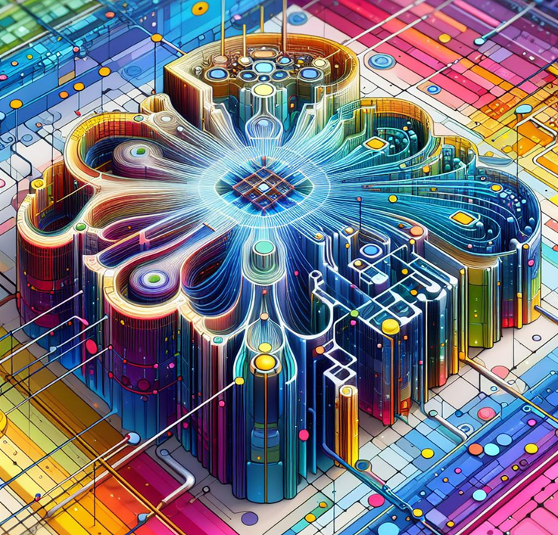
Maximum prompt size
The maximum size of the prompt in a LLM is called context size
Prompts are converted into tokens
English: 1 word ≈ 1.3 tokens
GPT3 from 22-11-2022:
2.048 tokens ≈ 5 pages
GPT4 from 14-3-2023:
8.096 tokens ≈ 20 pagina’s

Slide 22

What to do if your prompt doesn’t fit?
Cut the information into smaller pieces and present them one by one
After the last part you ask the question
Or, search the information for relevant paragraphs with a regular search engine
Create a prompt with the found paragraphs and the question to the user and offer it to ChatGPT
The latter can be automated:
Retrieval Augmented Generation (RAG)

Slide 23
Prompt engineering with ChatGPT for DF
Our 4 case study experiments:
Writing search queries
Summarising chat conversations
Analysing search results
Reverse engineering
In part I Colab we will focusses on #1, #3 and #4
Midjourney prompt: photorealistic picture of a digital sleuth in the style of Sherlock Holmes as a robot investigating a crime scene with digital traces in smartphones and computers (fast)

Slide 24
More on prompt engineering
Videos and articles by David Shapiro:
https://medium.com/@dave-shap/become-a-gpt-prompt-maestro-943986a93b81
On YouTube: https://www.youtube.com/watch?v=aq7fnqzeaPc
About System Prompts: https://www.youtube.com/watch?v=oILYjtbmLgc&t=760s
Video and notebook by AssemblyAI:
Prompt Engineering 101
https://www.youtube.com/watch?v=aOm75o2Z5-o
Prompt_Engineering_101.ipynb
https://colab.research.google.com/drive/1lHd9b8C4ccAGpkK06dzcFB0asjXWGZi0

Slide 25
Exercise II: prompt engineering & ChatGPT 3.5
Link:
https://github.com/HansHenseler/DFRWS-APAC-LLM-Workshop
Notebooks:
Part II: Prompt engineering with ChatGPT for Digital Forensics
Part III: Handson with Llama2
Part IV: Retrieval Augmented Generation with Llama2
Requirements:
You need to have an account to chat with ChatGPT 3.5 (free)
You can open the notebook in Google CoLab for better navigation

Slide 26
Break
Time | Title
11:00 | Introduction Large Language Models
11:30 | Part I: Hands-on prompt engineering for digital forensics
12:15 | Break
12:30 | Part II: Hands-on with Llama2
12:50 | Wrap up

Slide 27
Agenda
Time | Title
11:00 | Introduction Large Language Models
11:30 | Part I: Hands-on prompt engineering for digital forensics
12:15 | Break
12:30 | Part II: Hands-on with Llama2
12:50 | Wrap up

Slide 28
Part II
Hands-on with a local LLM in a Google Colab notebook

Slide 29
How to get LLMs
Subscribe to OpenAI GPT4, Google PaLM
Models are generally more powerful (Higher scores in various assessments)
No need to setup and maintain the models and hardware
Need to pay
Privacy problems
Setup a local in-house LLM
Many models are free
No privacy issue
Mid range hardware required
Self maintenance (very limited support from publishers)

Slide 30
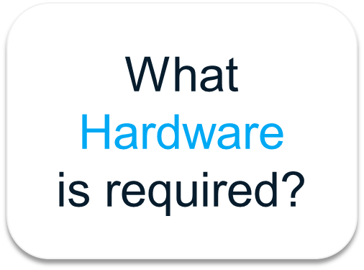
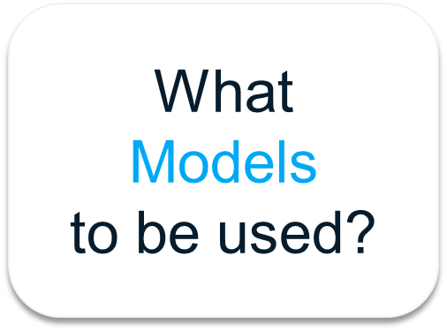
Local LLMs

Slide 31
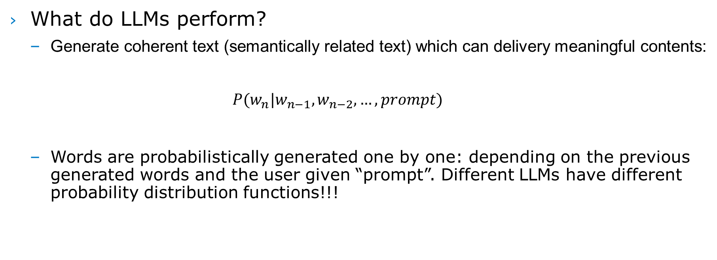
Background Info for Model Selection
What do LLMs perform?
Generate coherent text (semantically related text) which can delivery meaningful contents: $P(w_{n}|w_{n−1},w_{n−2},…,prompt)$
Words are probabilistically generated one by one: depending on the previous generated words and the user given “prompt”. Different LLMs have different probability distribution functions!!!

Slide 32
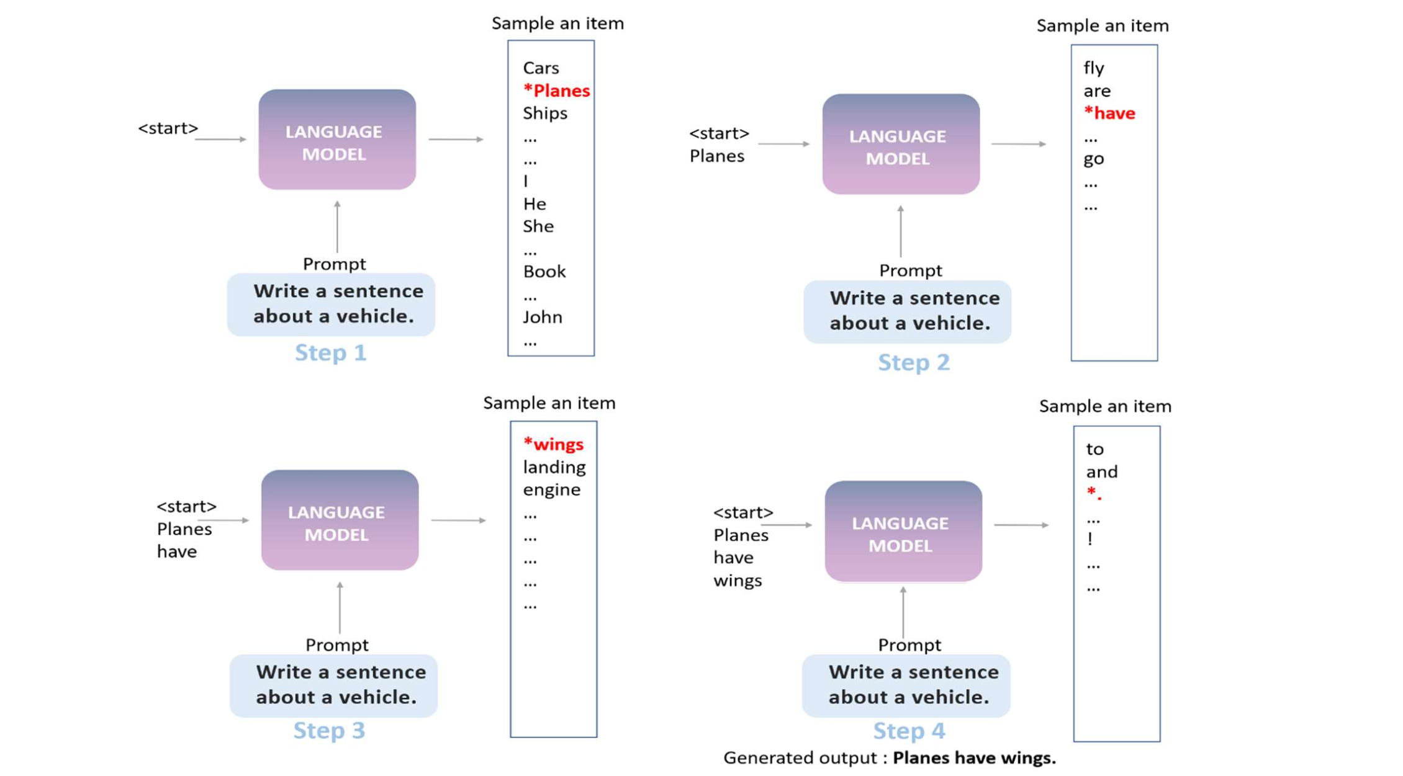
An example illustrating how LLMs generate words
using the prompt: “Write a sentence about a vehicle.”

Slide 33
Important Parameters for Local LLMs
Top_k | Only consider the top k words
Top_p | Only consider the top words having total probabilities ≤ Top_p
Temperature | Higher value → more diverse and creative content, but content may not be coherent or even irrelevant
n_ctx, max_length | Max. context length
Max_new_tokens | Max. number of tokens to be generated
Repeat_penalty | Discourage repetitive or redundant output

Slide 34
Local LLM Selection
Features of local LLMs to be considered:
Size of the models (num. of parameters/weights) | 7B, 13B, 30B, etc. Larger size models usually give better performance but require better hardware and slower
Nature of the models | Use instruct model or chat models for Q&A and Retrieval Augmented Generation (RAG)
Weight Quantization | Usually map floating point values (16bits/32bits) to integer values (int8, int4, etc)
Model Data Format/Structure | Hugging Face, GGUF, GGML (now replaced by GGUF), GPTQ, AWQ
Context length (tokens) | 2K, 4K, 8K, 32K…. ChatGPT : 8K, GPT4: 32K Number of context words ~ (0.6 or 0.7) * number of tokens

Slide 35


Parameter Quantization
Models are too big!
High VRAM GPU cards are too expensive! Almost no competitor !!!
Limited supply of high VRAM GPUs
Model computation is slow!
How to make models smaller, while preserving the number of parameters/weights, or minimizing the degradation of performance?
Use smaller number of bits to store the parameters/weights
Float32, float16 ---→ int8 (8-bit integer), int4, …
Faster computation

Slide 36
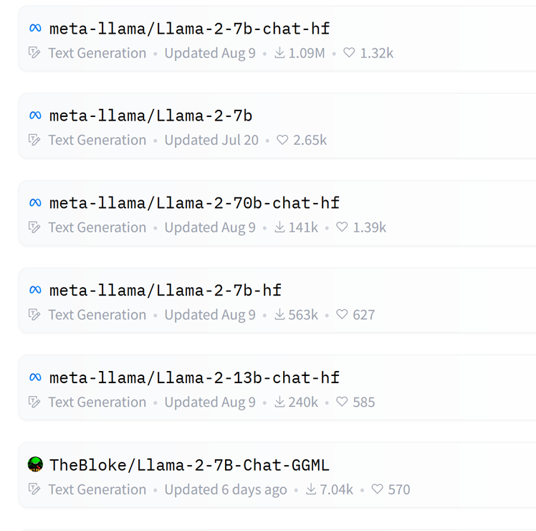
Frameworks
Hugging Face: Traditional framework
GGUF/GGML: Optimized for CPU and (CPU + GPU)
GPTQ: Optimized for GPU and (GPU + CPU)
AWQ: Recent efficient quantization method (size, speed)

Slide 37
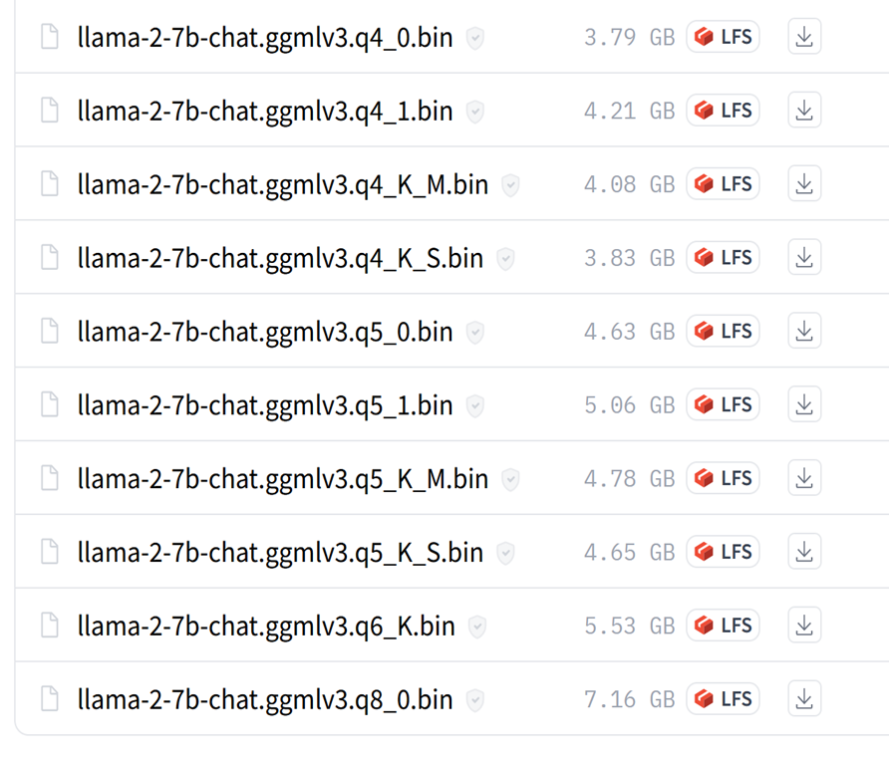
Llama 2 7B chat model
No. of parameters: 7B (float 16)
Memory required: ~ 14GB
Q4_0: 4bit quantization
7B parameters ~ 3.5GB
Q5_0: 5bit quantization
7B parameters ~ 4.4GB
Q6_K_S: 6bit K-quantization
7B parameters ~ 5.3GB
Q8_0: 8bit quantization
7B parameters~ 7.0GB

Slide 38
Exercise II: Hands on with Llama2
Link:
https://github.com/NetherlandsForensicInstitute/DFRWS-EU-2024-LLM4DF-Workshop
Notebooks:
Part I: Prompt engineering with ChatGPT for Digital Forensics
Part II: Hands-on with Llama2
Requirements:
Google CoLab is free but you need a Gmail account!
Make sure to select a T4 GPU

Slide 39
Agenda
Time | Title
11:00 | Introduction Large Language Models
11:30 | Part I: Hands-on prompt engineering for digital forensics
12:15 | Break
12:30 | Part II: Hands-on with Llama2
13:00 | Wrap up

Slide 40
Wrap up
What’s new and what’s coming?

Slide 41
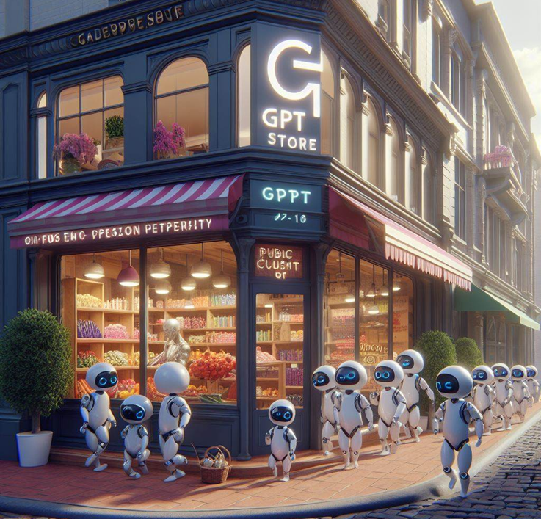
Custom GPTs from OpenAI: RAG & functions
With a ChatGPT plus subscription you can build a custom GPT
Tailored instruction
Proprietary documents (RAG)
Connection to online API’s (Functions)
OpenAI launched their GPT store beginning of 2024
In february it had 159.000 GPTs
https://chat.openai.com/gpts
Notes:
ChatGPT - ElevenLabs Text To Speech (openai.com)
ChatGPT - Cartoonize Yourself (openai.com)

Slide 42
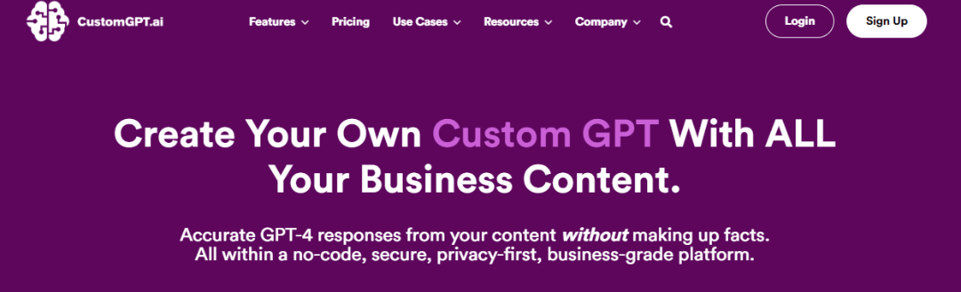

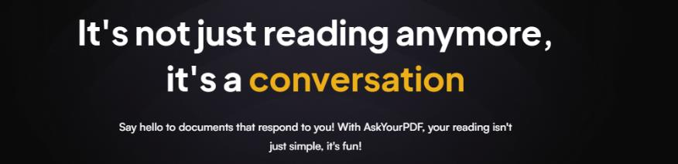
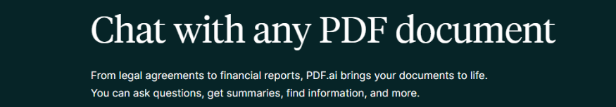

OpenAI Custom GPTs are not alone
https://customgpt.ai
https://www.perplexity.ai
https://auth.askyourpdf.com
https://pdf.ai
https://chatdoc.com

Slide 43
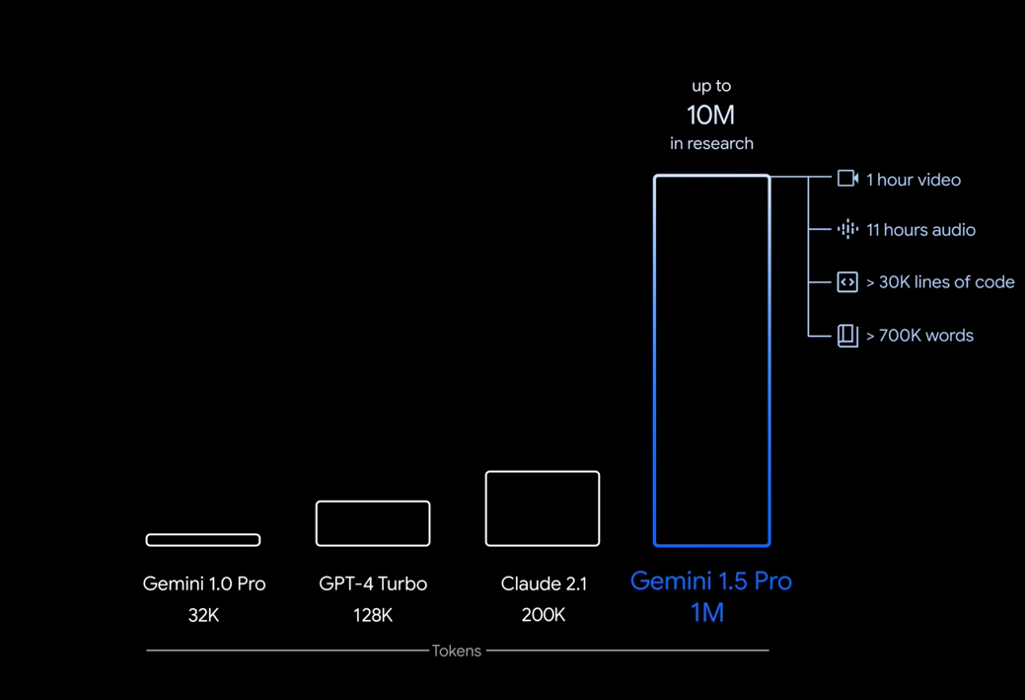
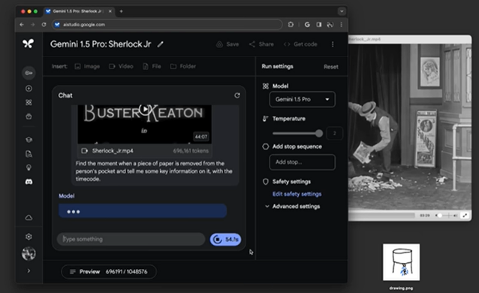
Google Gemini 1.5
Kort na het vrijgeven van Gemini 1.0 (advanced) kwam Google met de aankondiging van Gemini 1.5 https://blog.google/technology/ai/google-gemini-next-generation-model-february-2024
Gemini 1.5 heeft een context size van 1 miljoen tokens.
1.000.000 tokens ≈ 2.500 blz
Het model is nog niet beschikbaar maar Google heeft wel een aantal indrukwekkende demonstraties als video online gezet.
https://youtu.be/wa0MT8OwHuk

Slide 44

OpenAI Sora
SORA is een tekst naar video model en is op 15-2-2024 gelanceerd
Is in staat om op basis van een prompt 1 minuut video te genereren.
Is niet nieuw maar de kwaliteit is veel beter dan eedere modellen.
Volgens OpenAI is SORA kun je met SORA een wereld simuleren
https://openai.com/research/video-generation-models-as-world-simulators

Slide 45
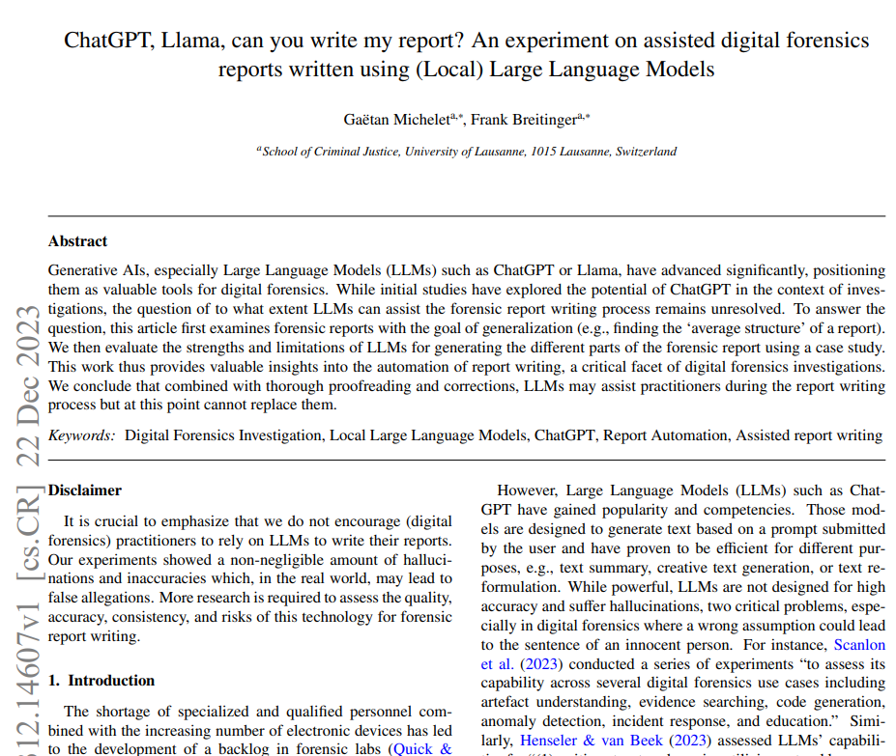
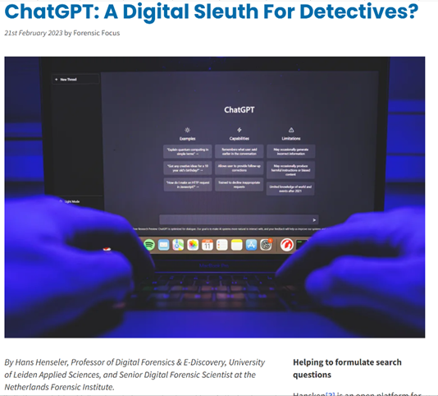
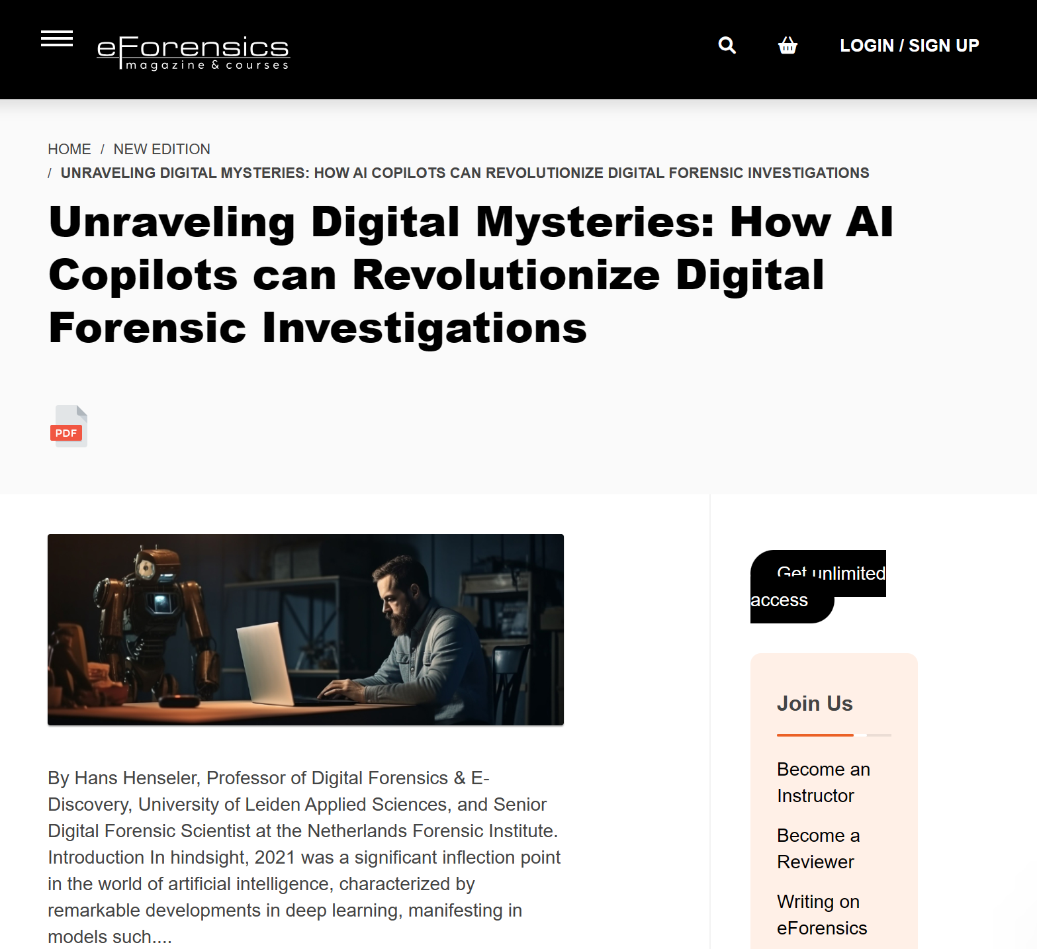
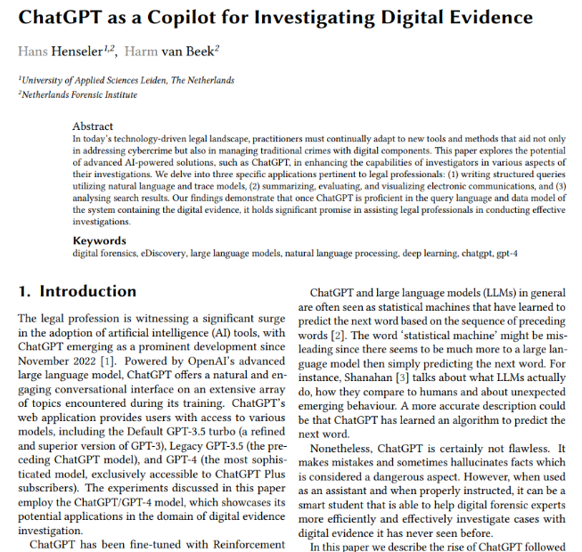
Thank you!
Hans Henseler
h.henseler@nfi.nl
Gaëtan Michelet
victor.cheng@tauexpress.com
Published papers and articles:
https://arxiv.org/pdf/2312.14607.pdf
https://www.forensicfocus.com/articles/ chatgpt-a-digital-sleuth-for-detectives
https://eforensicsmag.com/unraveling-digital-mysteries-how-ai-copilots-can-revolutionize-digital-forensic-investigations/
https://ceur-ws.org/Vol-3423

